Slide 1
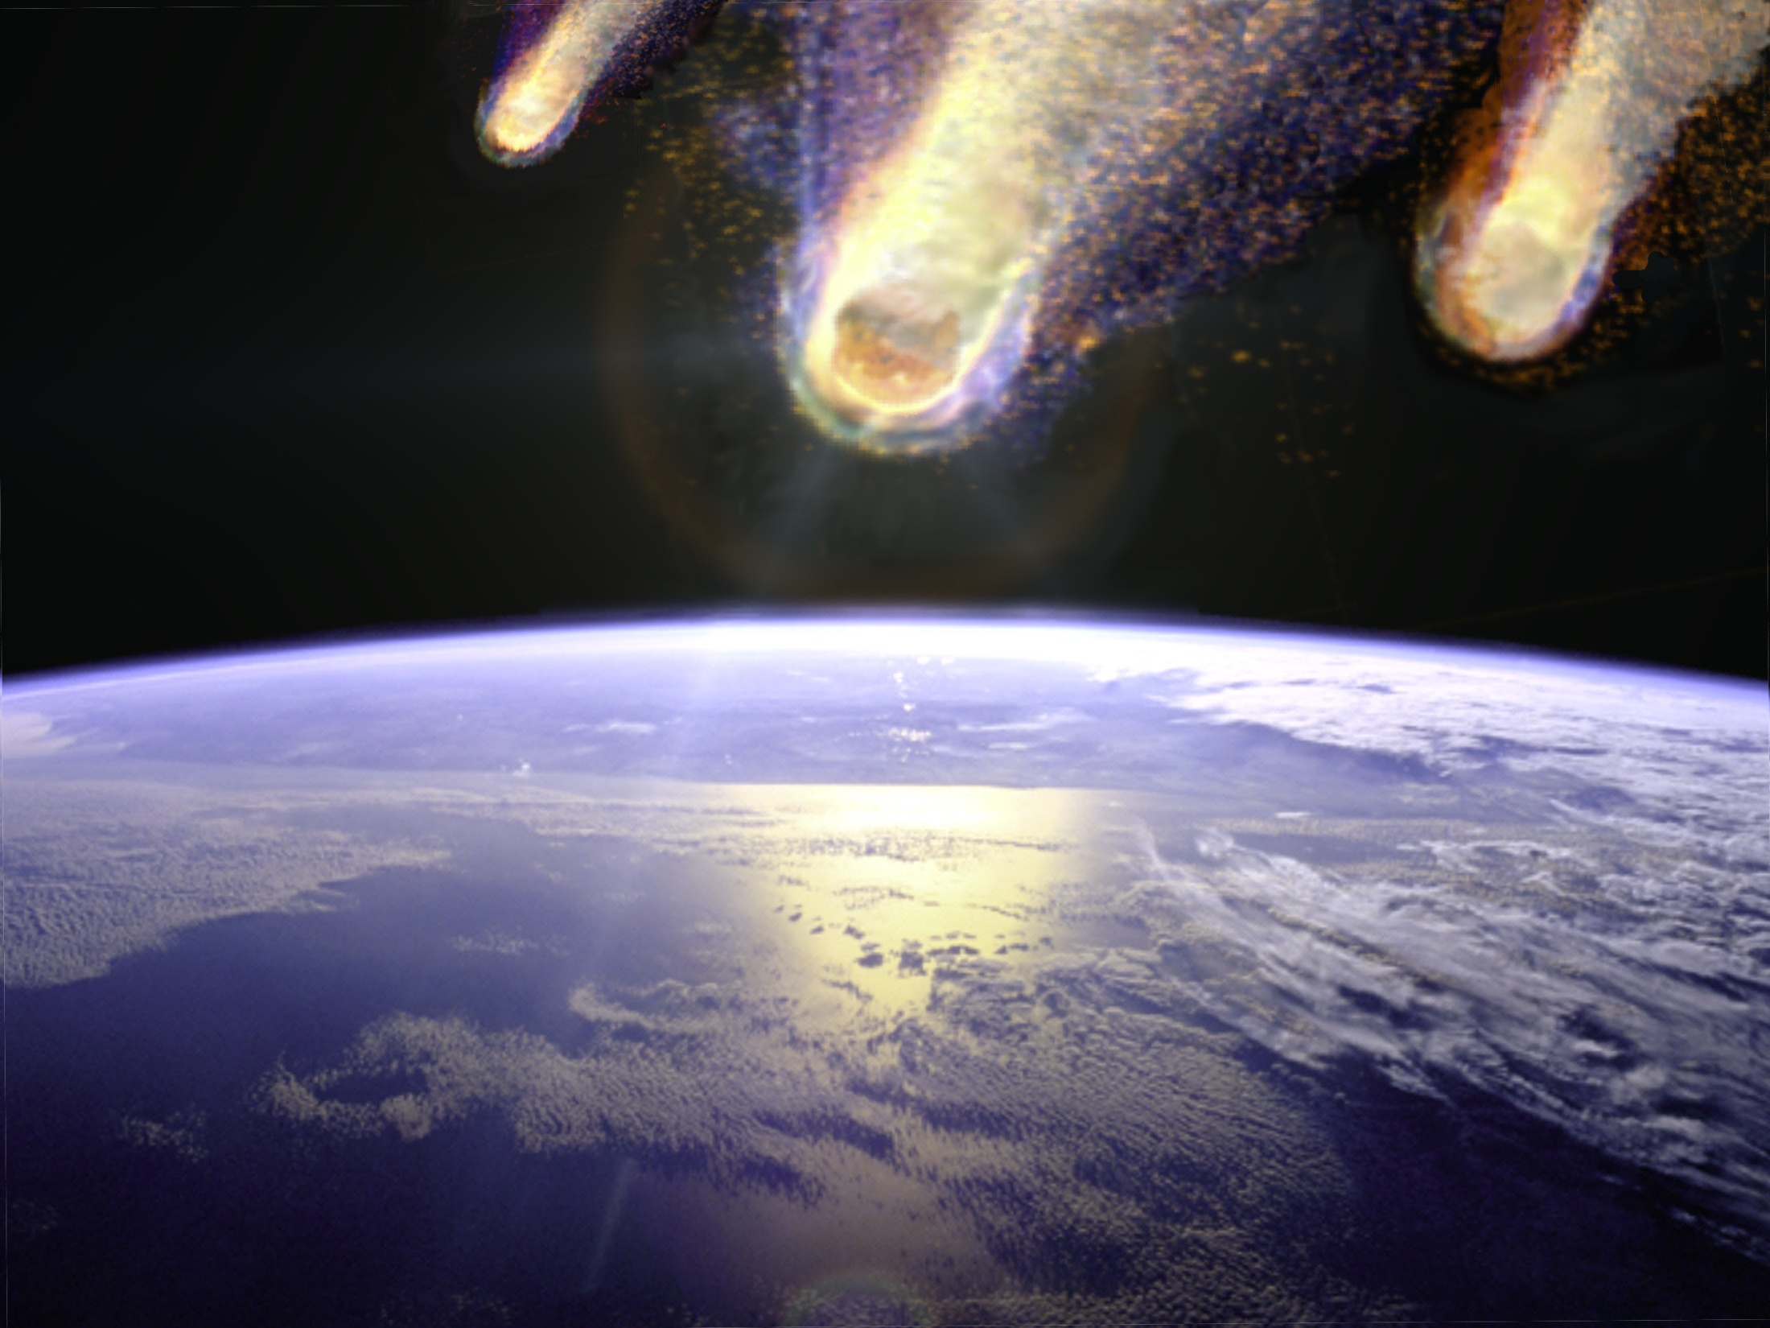
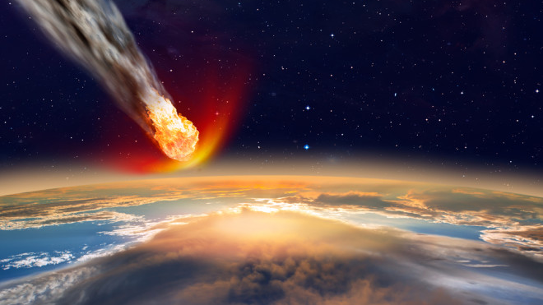
EVIDENCE FOR AN ICE AGE IMPACT

Slide 2
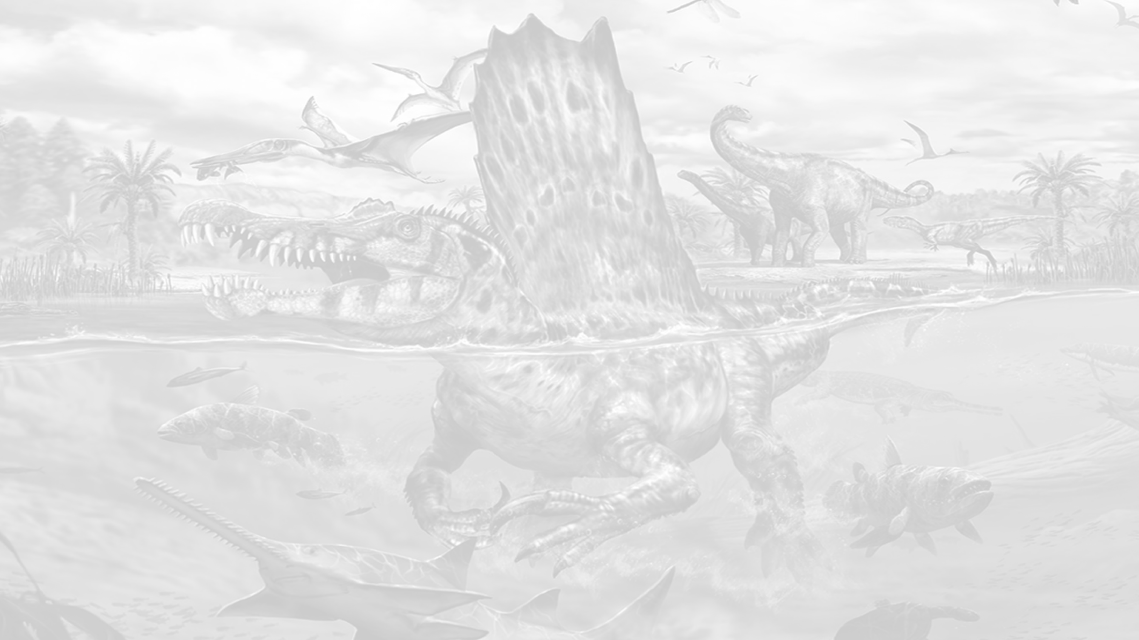
The well accepted “Mysteries”
What happened to America’s Clovis people?
What happened to all the cool, giant mammals?
What caused the flood (mythical and actual)?
Why did we change so dramatically 13,000 years ago?
2

Slide 3
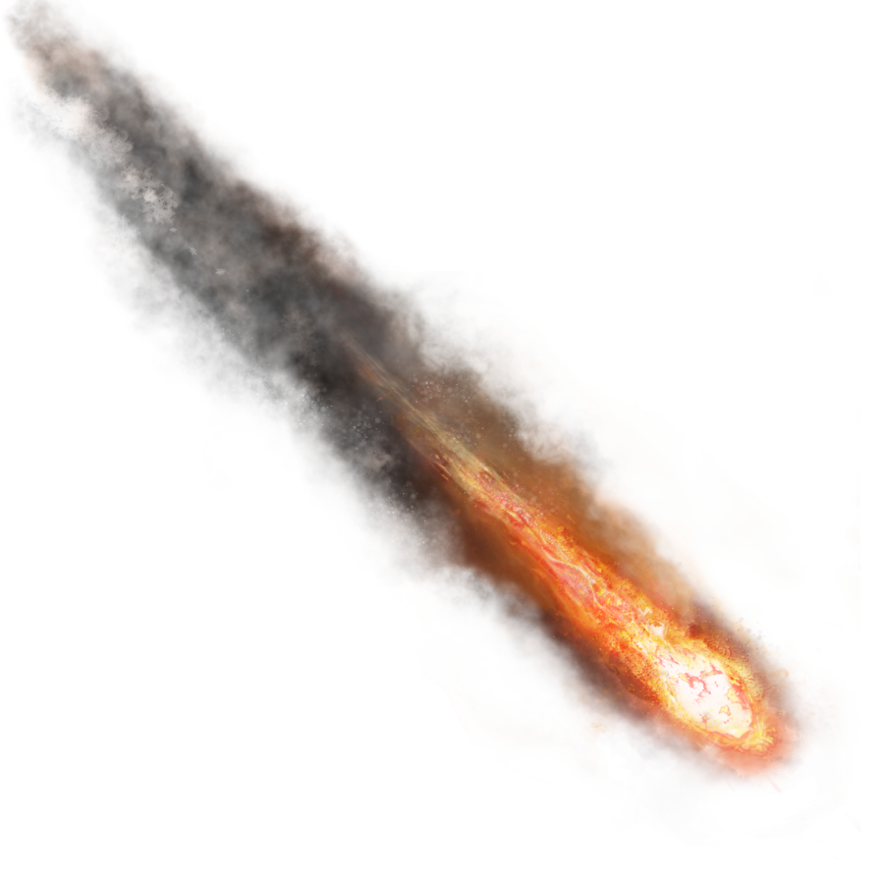
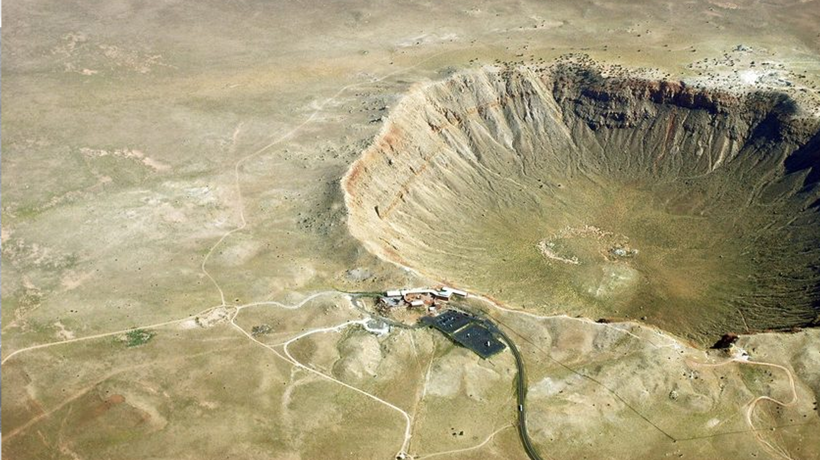
Hypothesis
An ET Impact Event occurred 12.9 ka ago:
1000s of airbursts across N & S Hemispheres
Debris across 4 continents (YDB layer)
Cubic kms of meltwater
Halted N. Atlantic ocean circulation
Initiated Younger Dryas (YD) cooling
Contributed to megafaunal extinction
Triggered collapse of the Clovis culture
Notes:
Profound. I believe we are naked apes with black mirrors because of this event. Everything changes at the YD. That is well excepted.

Slide 4

The Evidence
40+
sites
California to Germany alone
>25% of N. Hemisphere
Found no boundaries yet
12
countries
4
continents

Slide 5
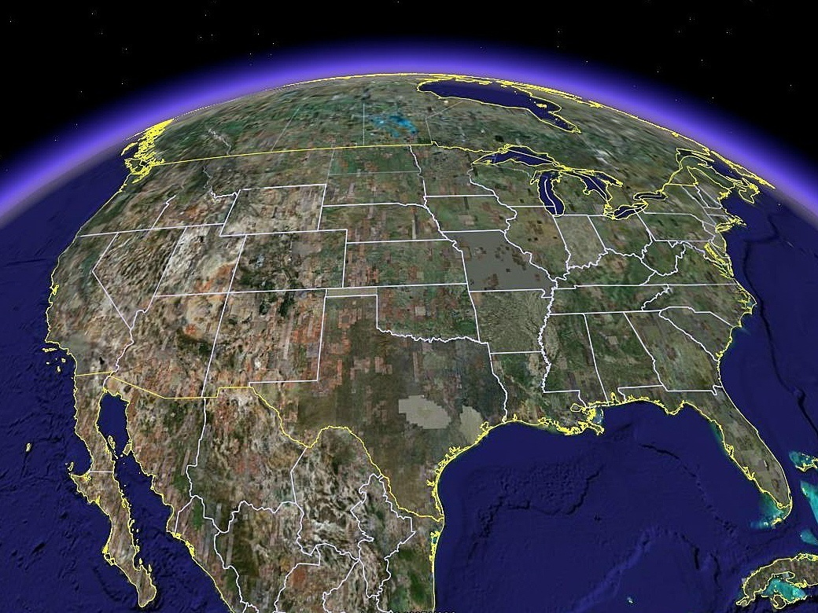



Gainey, MI

Slide 6
Alberta
and Manitoba
(Wally’s Beach)

Slide 7
Daisy Cave
& Arlington
Springs

Slide 8
Murray Spgs
& Lehner

Slide 9
Blackwater Draw, NM

Slide 10
Topper, SC

Slide 11
Carolina Bays

Slide 12
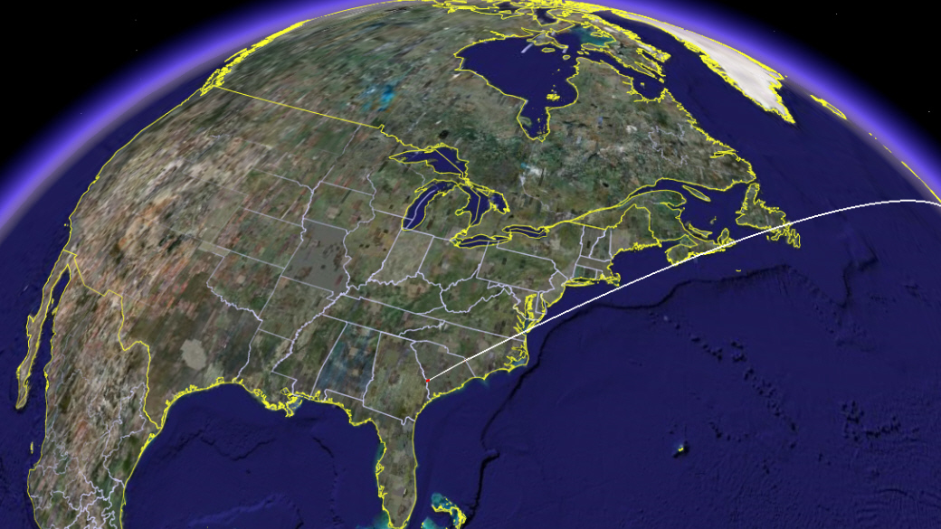





Europe
Germany, Belgium, Netherlands
6800 km
(4200 mi)
6800 km
(4200 mi)
Topper

Slide 13
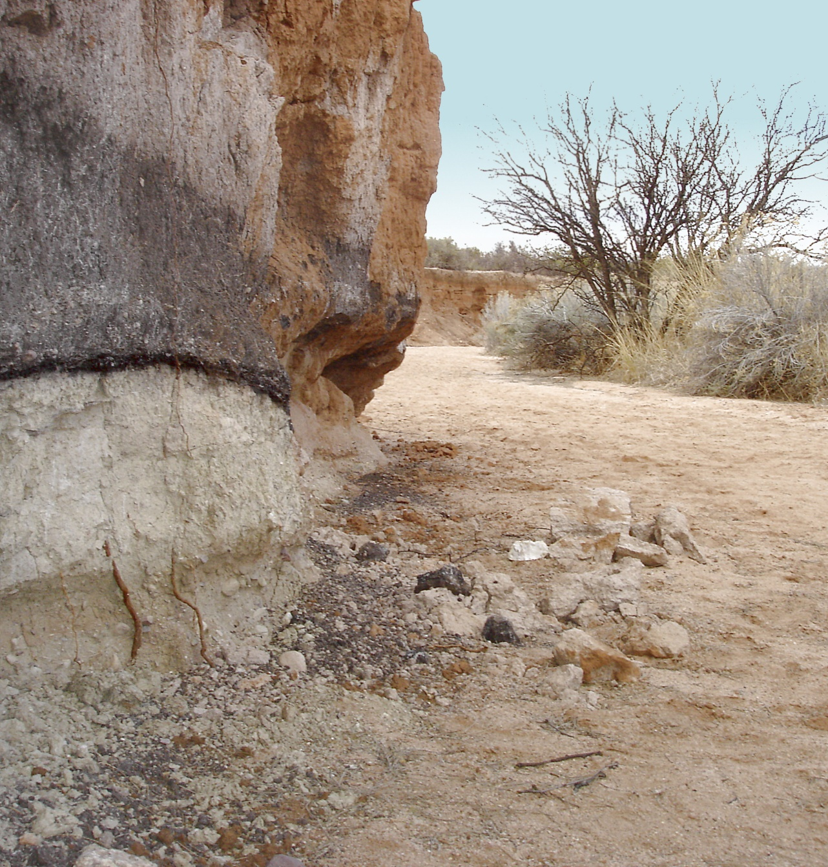
Murray
Springs, AZ
Clovis Campsite
and
Mammoth Killsite

Slide 14
Murray
Springs, AZ
CLOVIS-ERA PEAKS:
Black mat (12.9 ka)

Slide 15
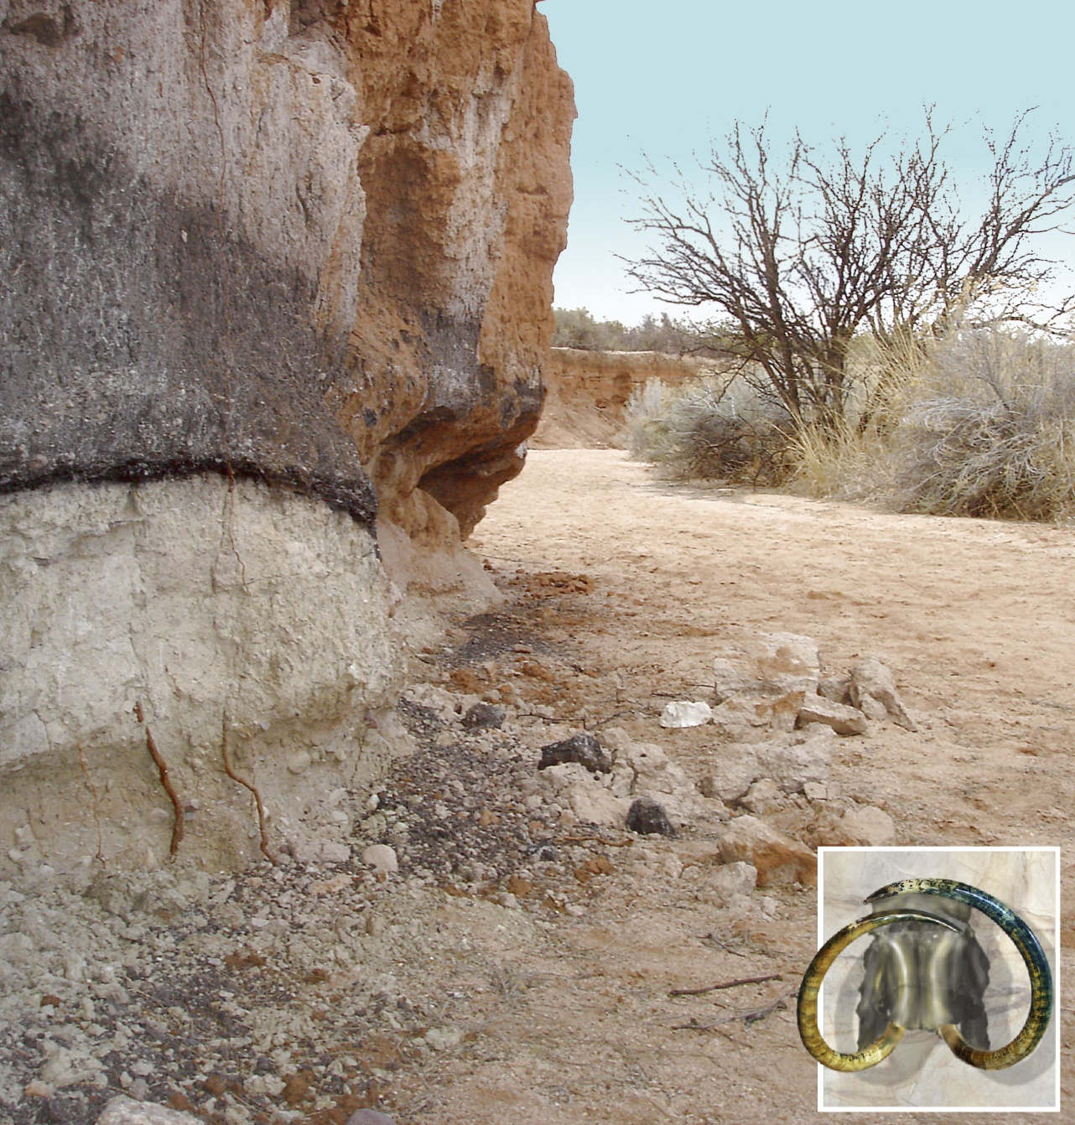
Murray
Springs, AZ
CLOVIS-ERA PEAKS:
Mammoth/camel/horse
Black mat (12.9 ka)
Extinction

Slide 16
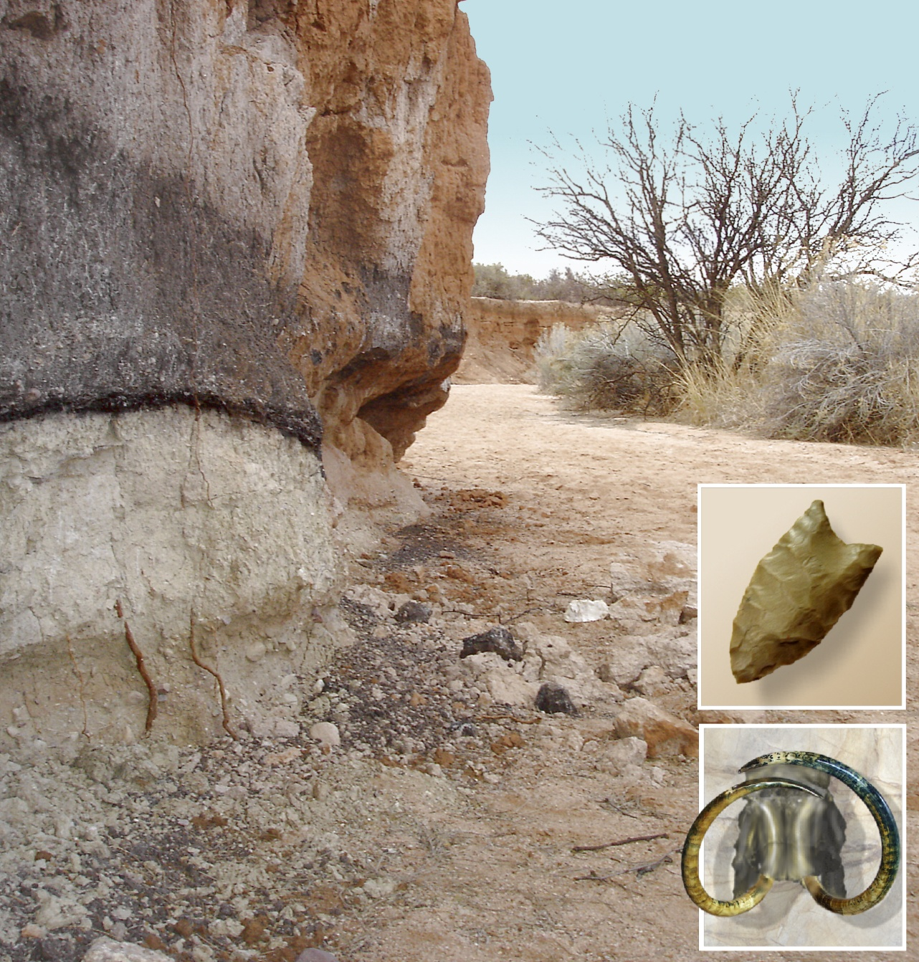
Murray
Springs, AZ
CLOVIS-ERA PEAKS:
Clovis artifacts
Mammoth skeletons
Black mat (12.9 ka)

Slide 17
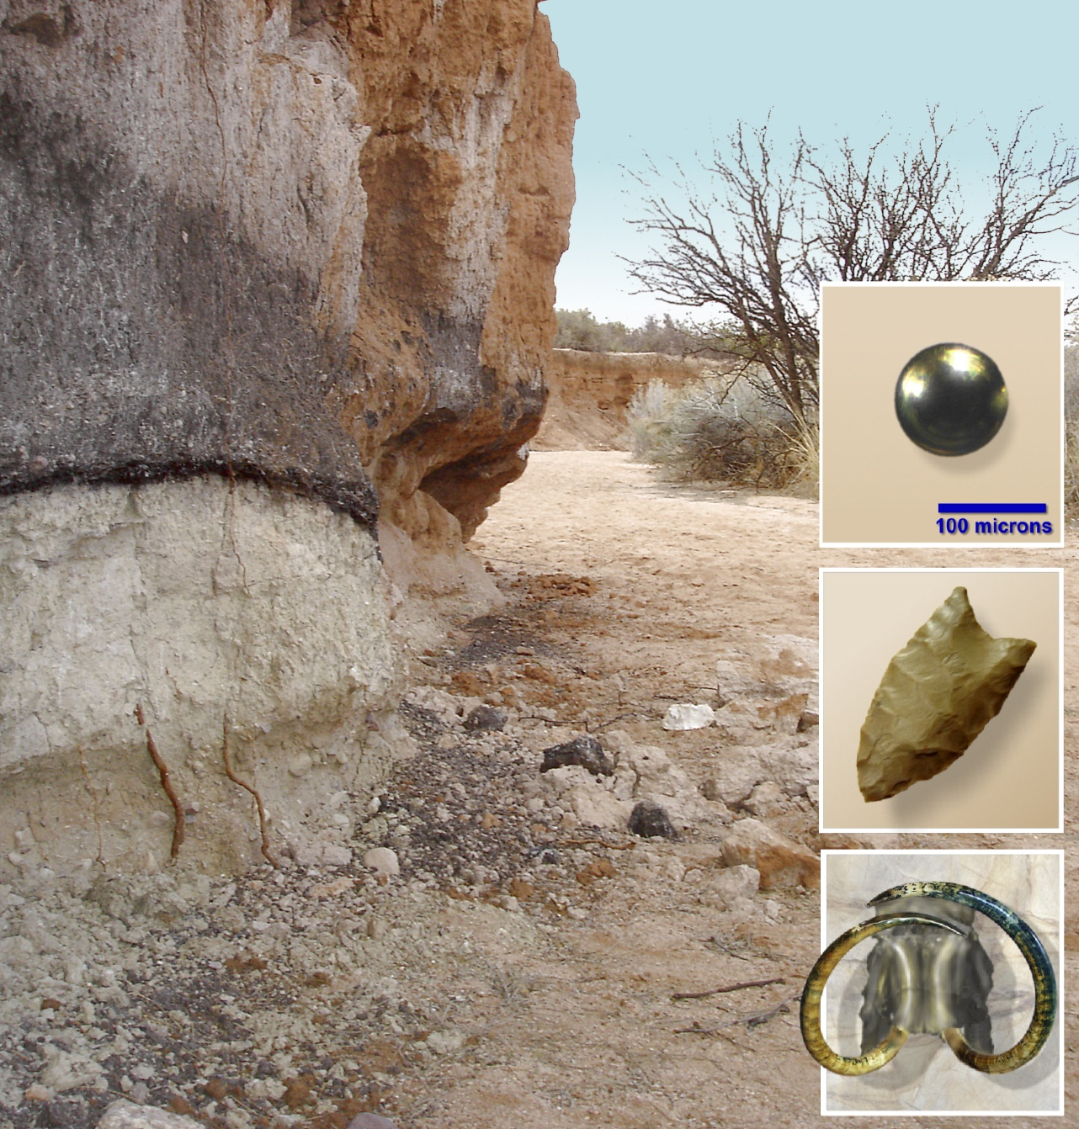
Murray
Springs, AZ
CLOVIS-ERA PEAKS:
Magnetic spherules
Platinum, iridium
Nanodiamonds
Clovis artifacts
Mammoth skeletons
Black mat (12.9 ka)

Slide 18
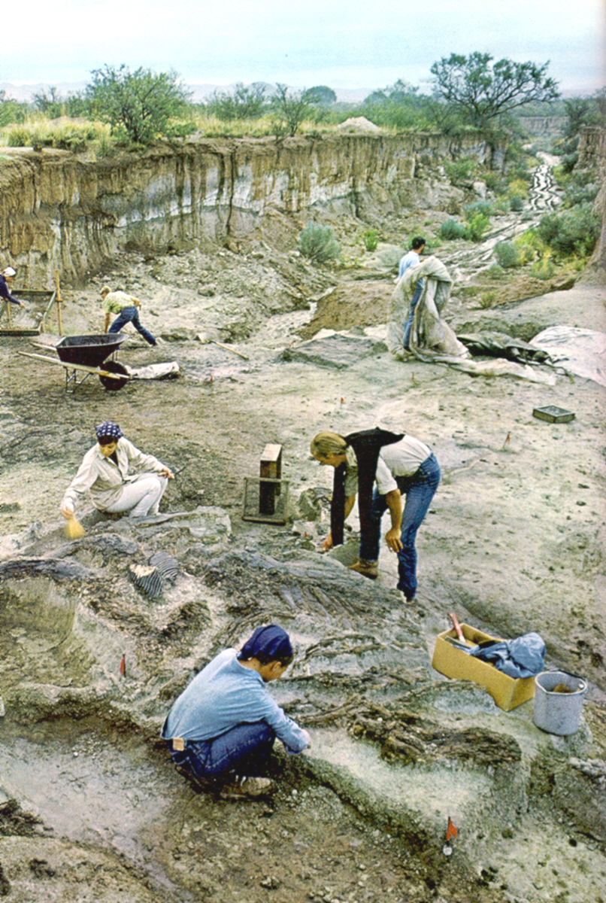
Murray Springs
Mammoth
Black mat (12.9 ka)
“Eloise” the Mammoth; bones stained black by mat
Extinction layer; no in situ bones or Clovis artifacts in mat or above at 50 sites
Impact markers cover the bones just below the mat
One of last mammoths? Buried a few days before the YD Impact Event
Impact
Markers
Extinction Layer

Slide 19
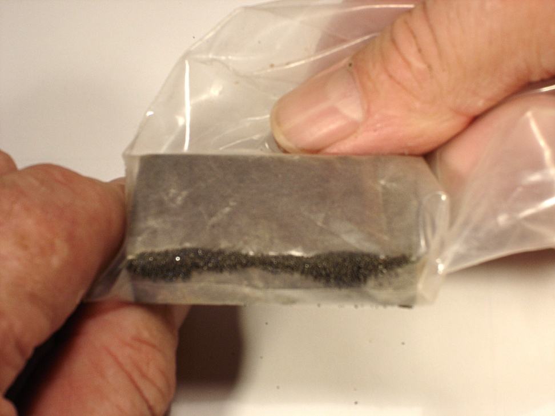
Site Testing
Event Markers:
Neodymium magnet
Magnetic grains

Slide 20
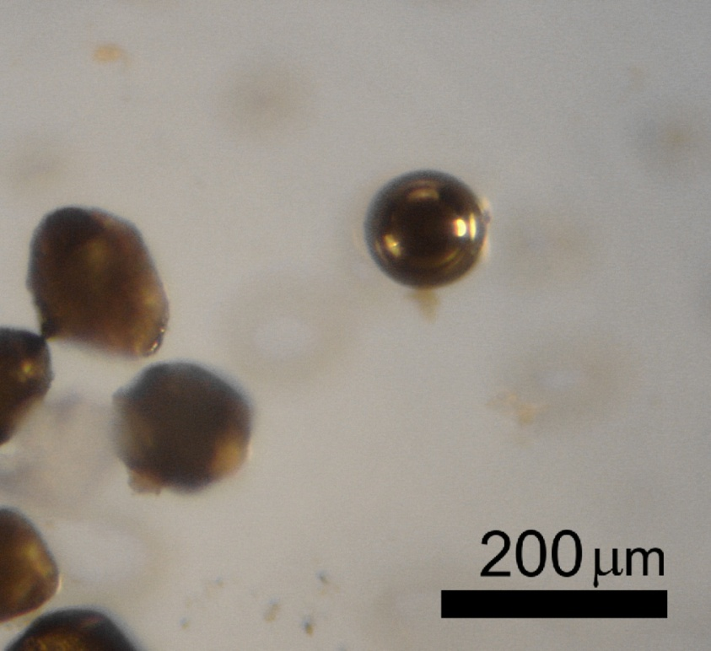
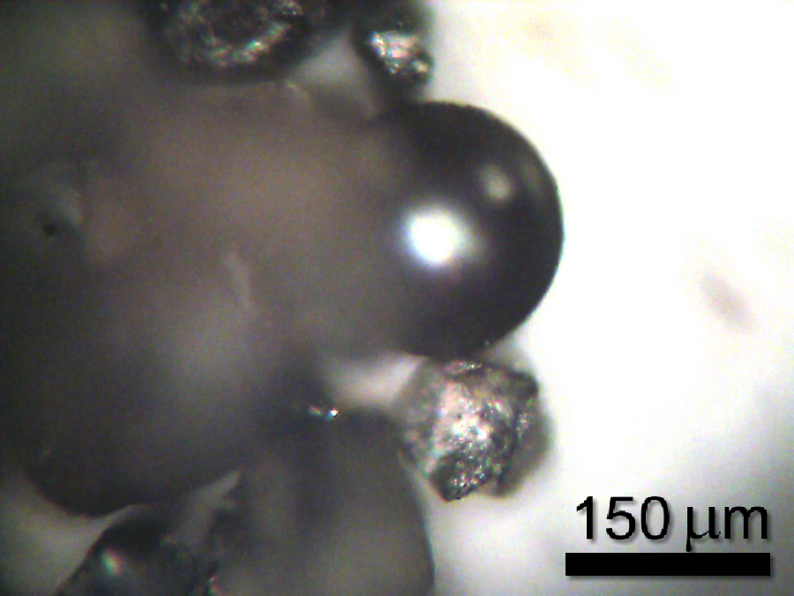
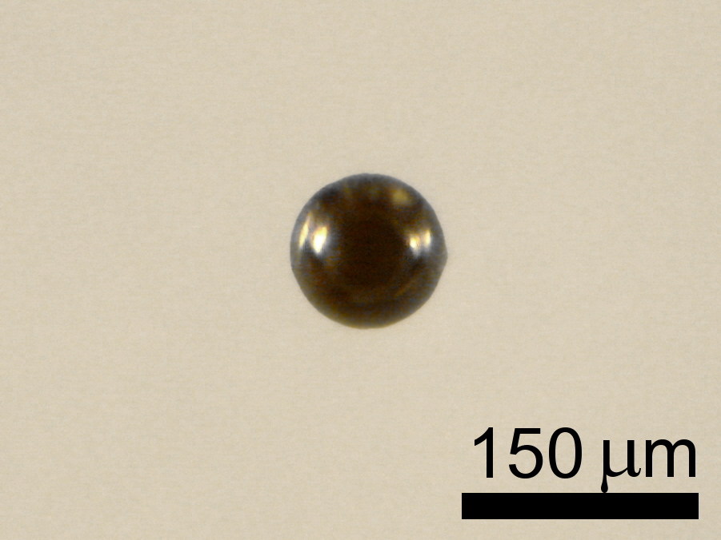
Magnetic
Spherules
Smaller than a
speck of dust
From the Gainey Site, Michigan

Slide 21
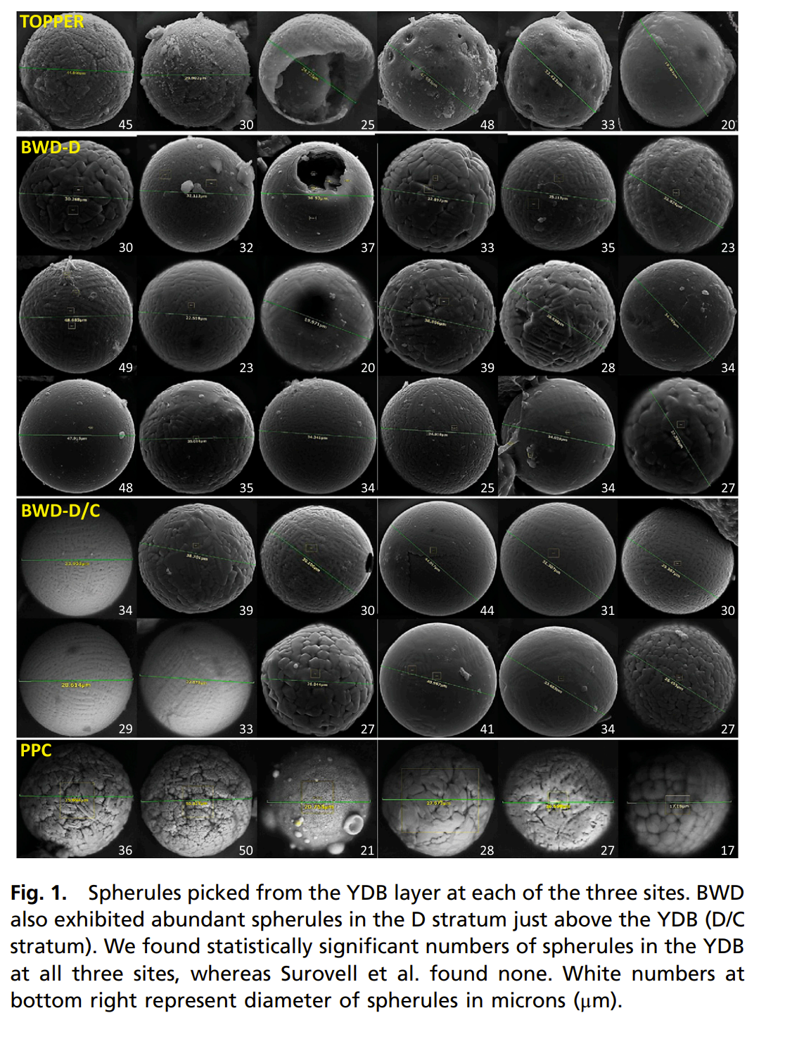
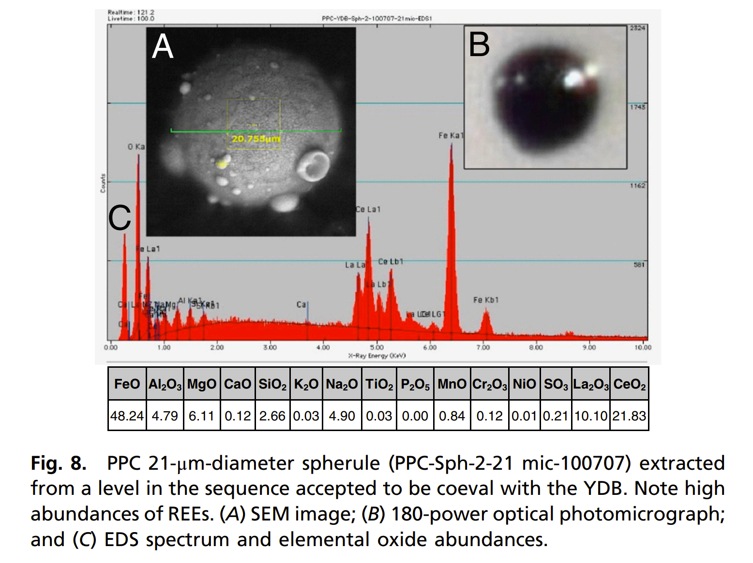

Slide 22
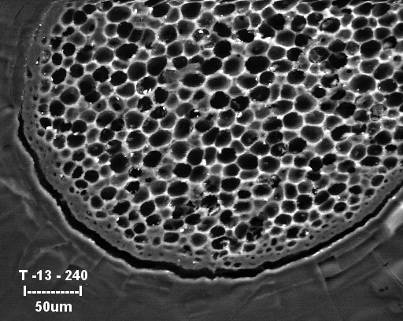
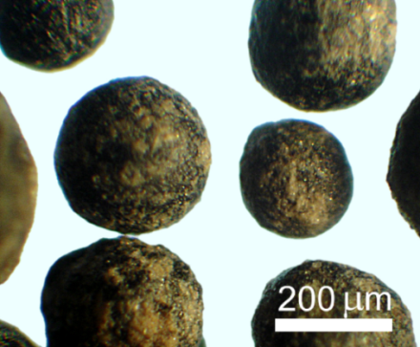
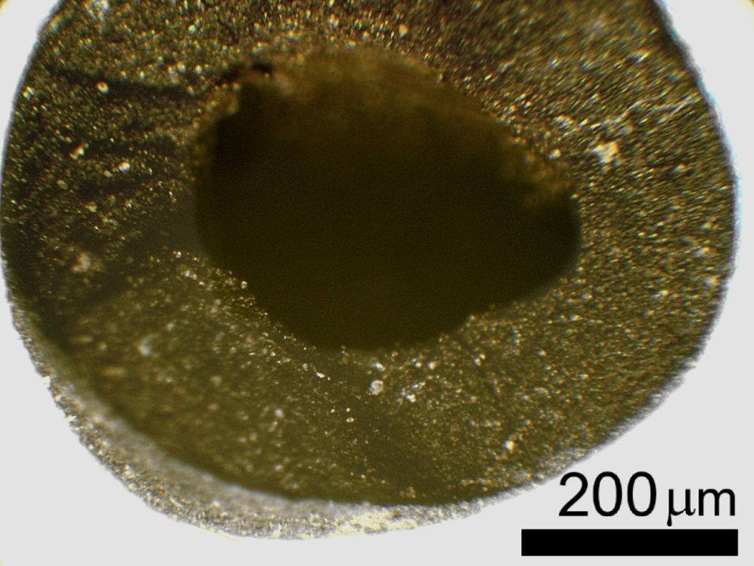
250
Carbon spherules
Mostly carbon
Up to 3-4 mm (~1/8”)
Roughly spherical
Hard shell
Spongy interior

Slide 23
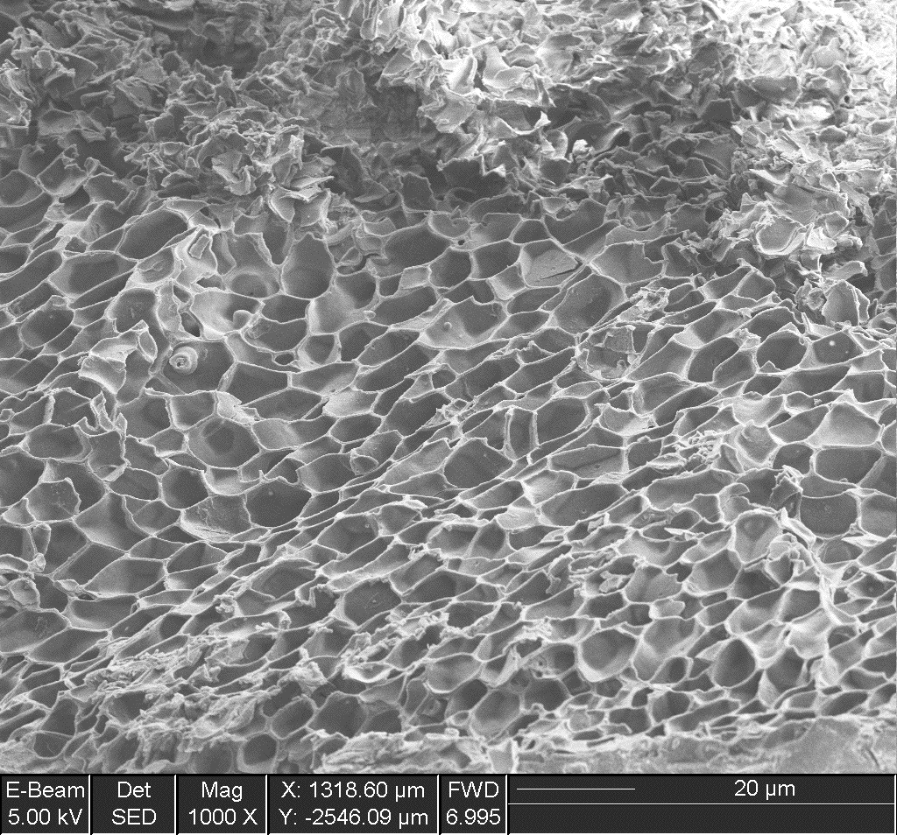
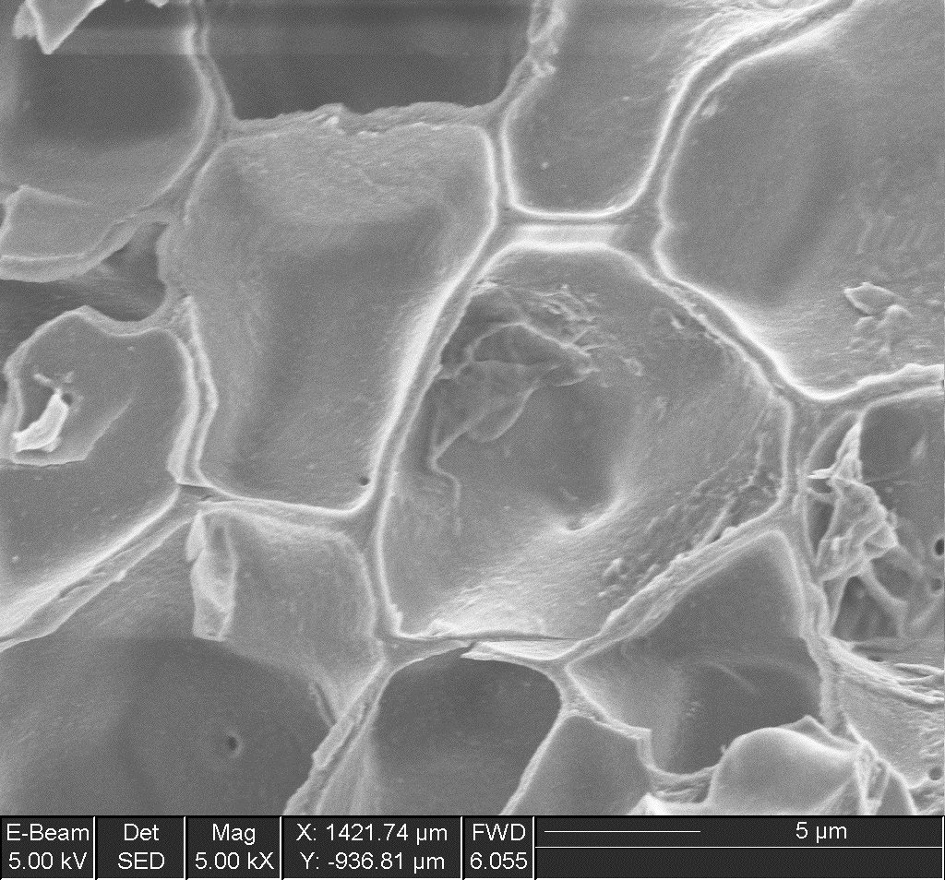
Carbon Spherules
Gas-formed vesicles
C. Mercer, A. Evans

Slide 24
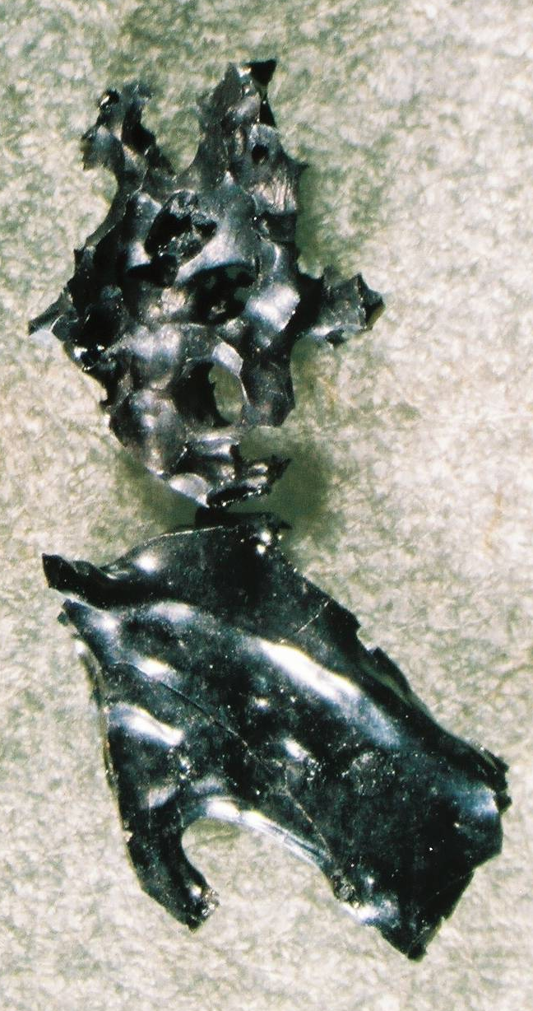
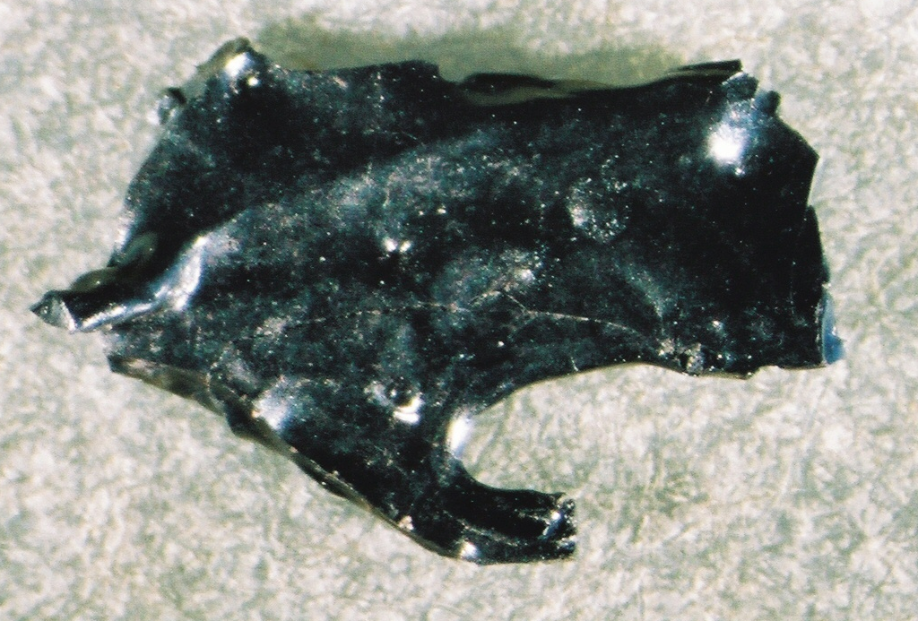
Gas-like Carbon
5 mm
Carbon spherules and glass-like carbon
are signs of
intense firestorms.

Slide 25
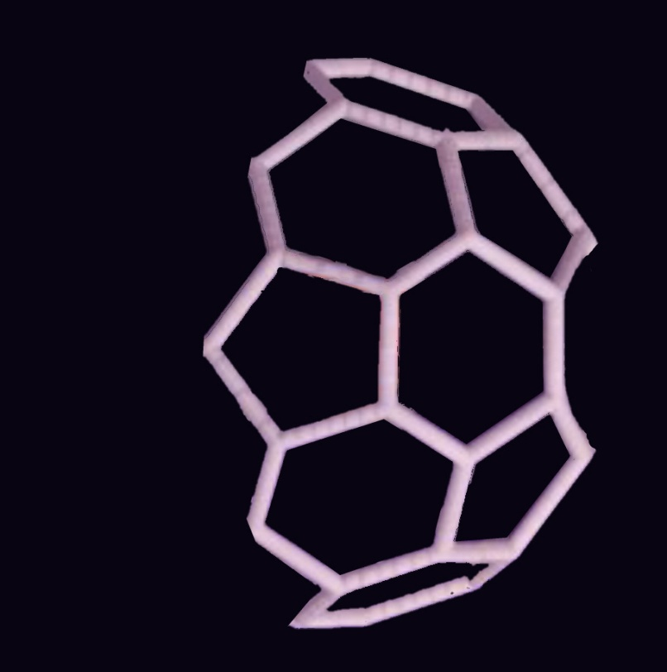

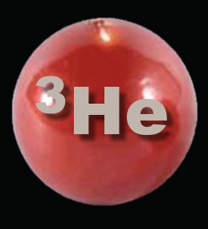
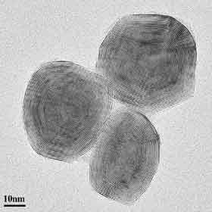
ET Fullerenes
Fullerenes, cage of carbon atoms; rare on Earth, but common in most meteorites
Helium-3 trapped inside fullerenes; also rare on Earth
“Soccer-ball-like” fullerenes
(Tenne, 2007)

Slide 26

Trillions of
Nanodiamonds
YDB layer contains surprising things, but…
were the biggest surprise

Slide 27
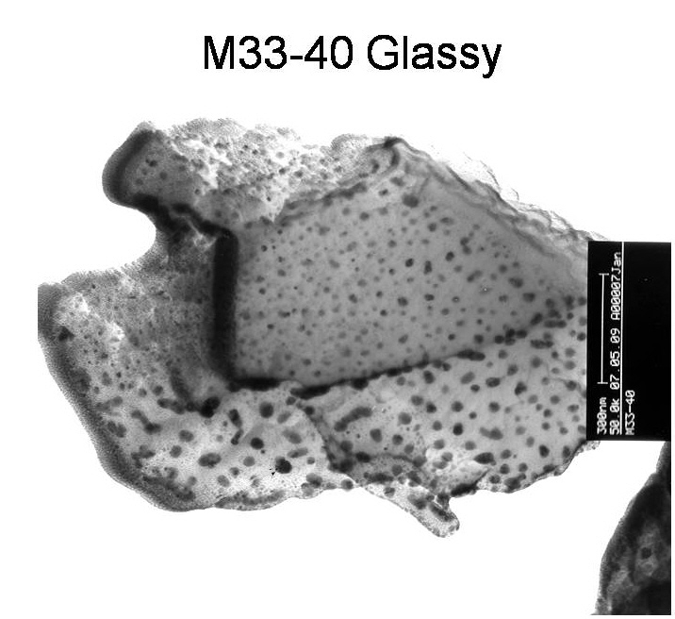
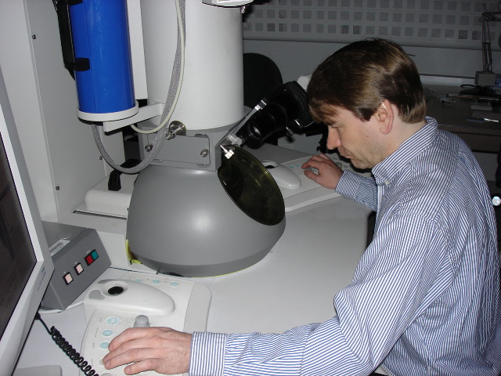
S. Carolina
1000 times smaller than human cells or bacteria.
Major ET Marker:
Glass-like Carbon +Nanodiamonds
(black dots)
Transmission electron microscope at UCSB

Slide 28
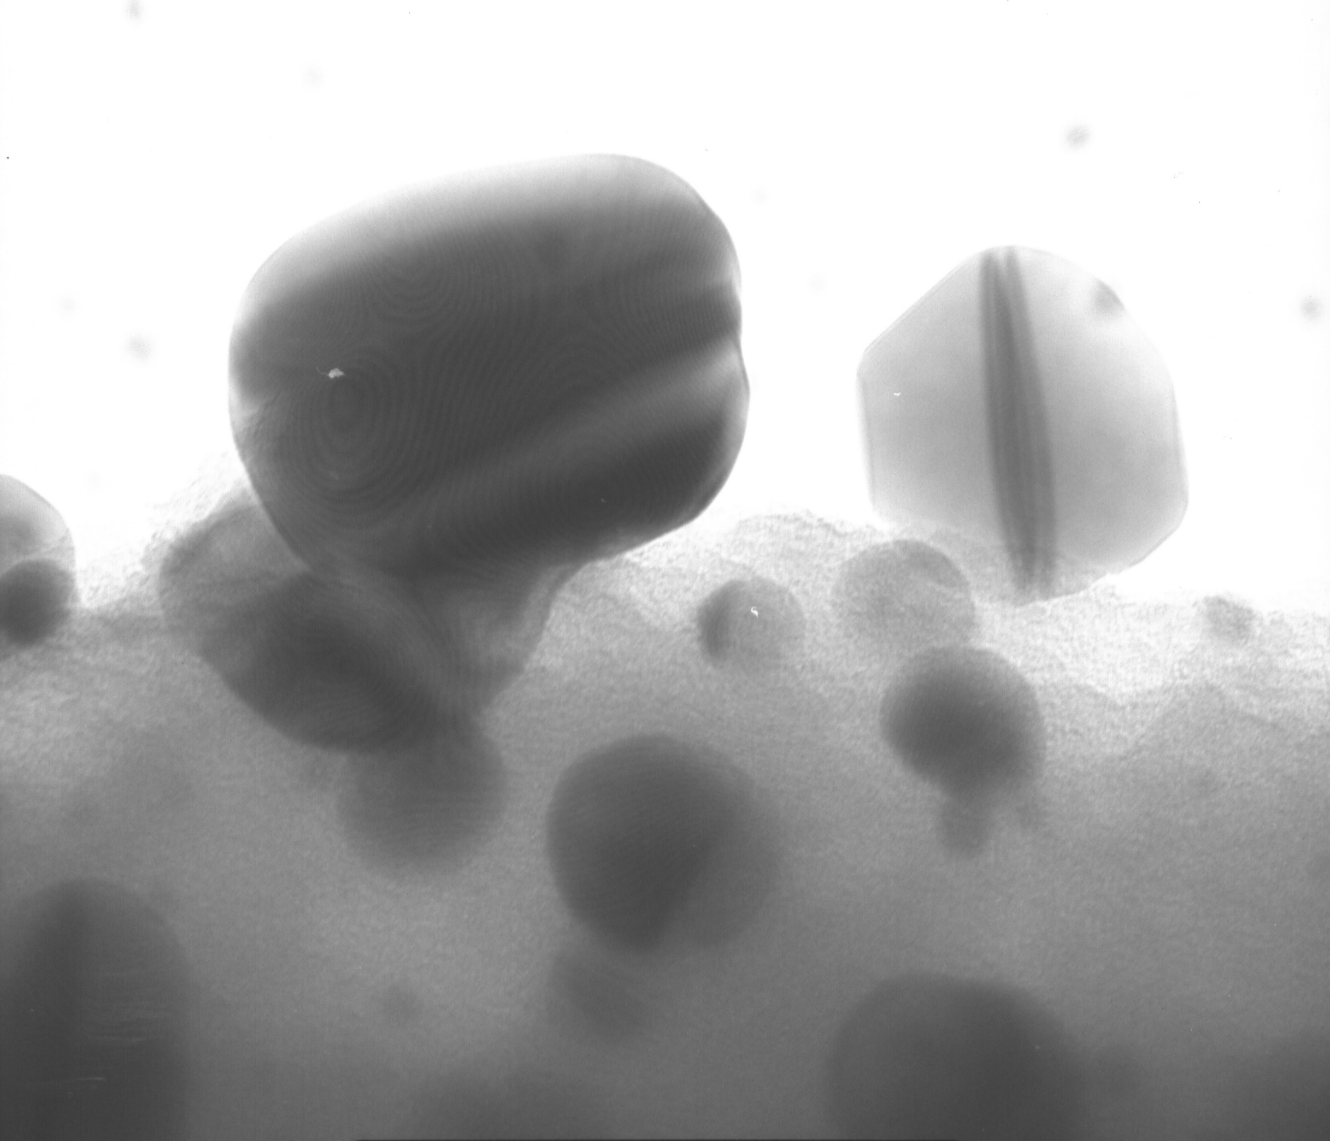
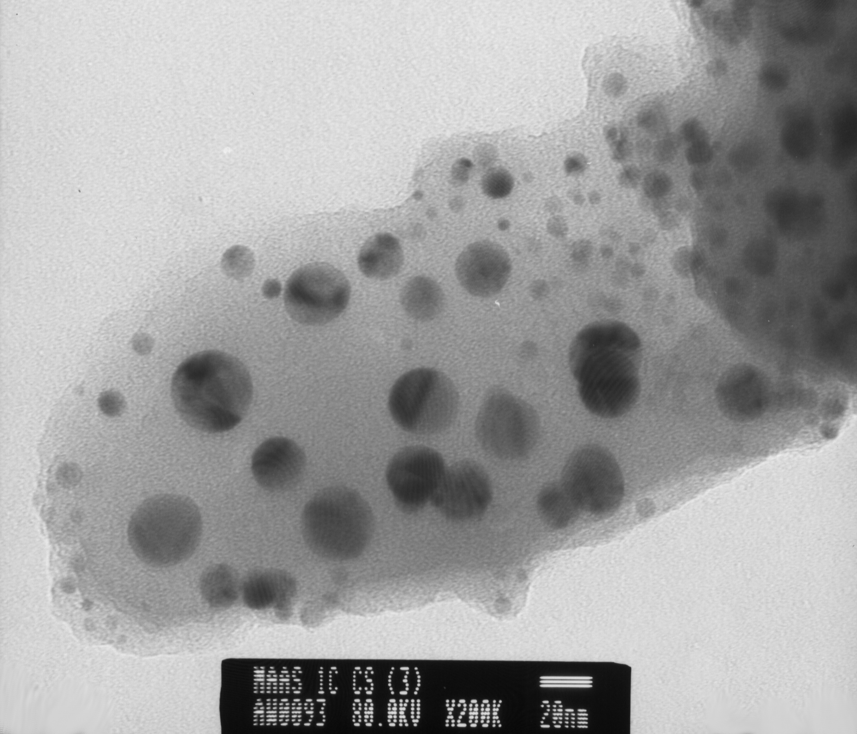
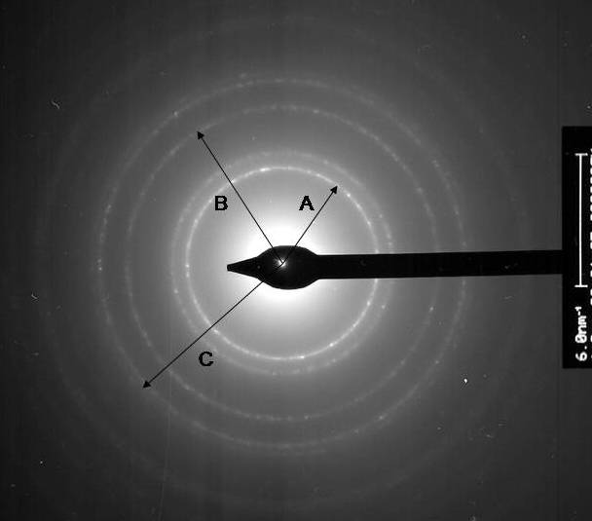
Twinned
Octahedral
Diamond
Alberta, CAN
Typical diamonds
Diffraction pattern
of diamond

Slide 29


YDB layer
Carbon

Slide 30

YDB layer
Sediment
Notes:
Allen?

Slide 31
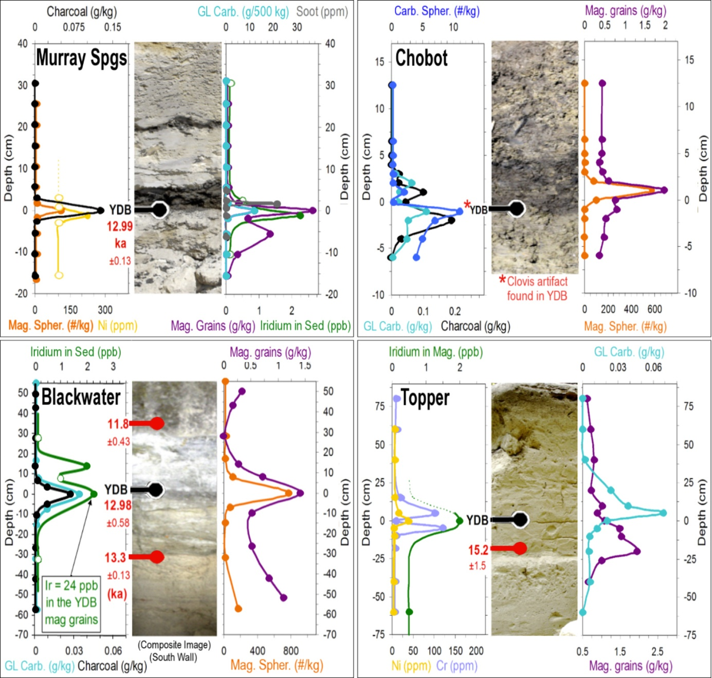
Clovis Campsites

Slide 32
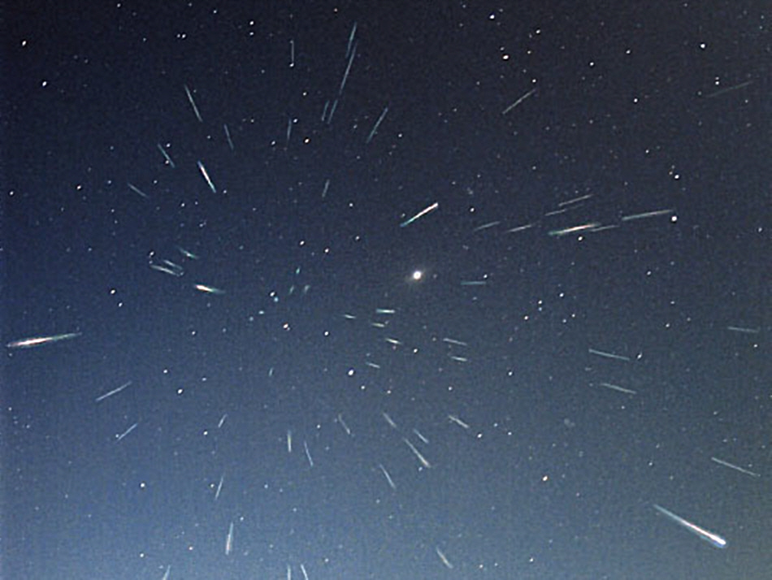
50
14 lines of evidence...
are they impact-related
or just
the normal rain of meteoritic debris?
Leonid meteor shower

Slide 33
>Background
>56,000 times
14/14

Slide 34
>Background
>56,000 times
14/14

Slide 35
>Background
14/14

Slide 36
>Background
>6,000 times
14/14

Slide 37
>Background
14/14

Slide 38
>Background
>14,000 times
14/14

Slide 39
>Background
14/14

Slide 40
>Background
14/14
>20,000 times

Slide 41
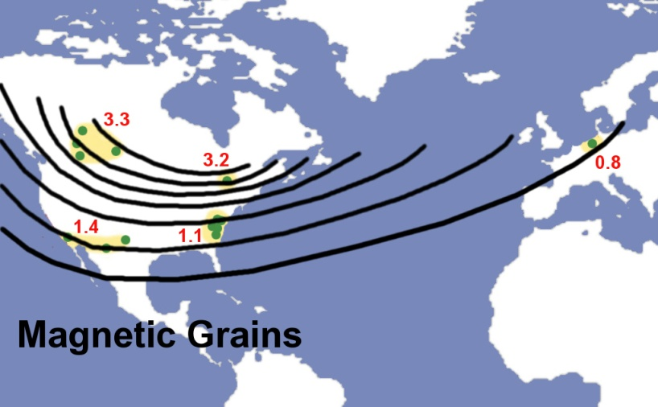
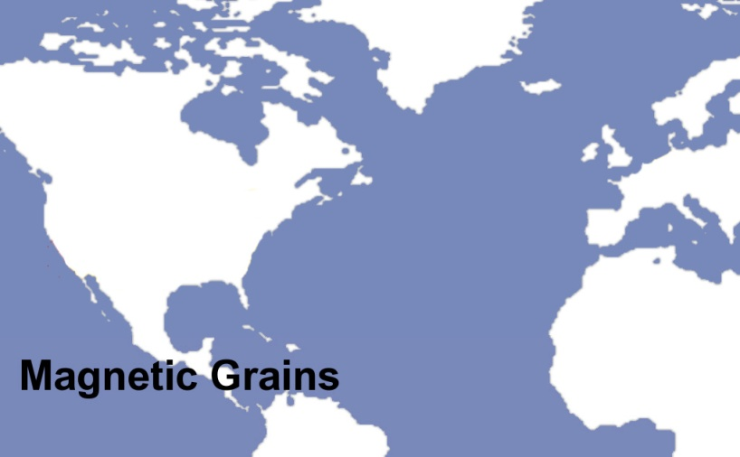




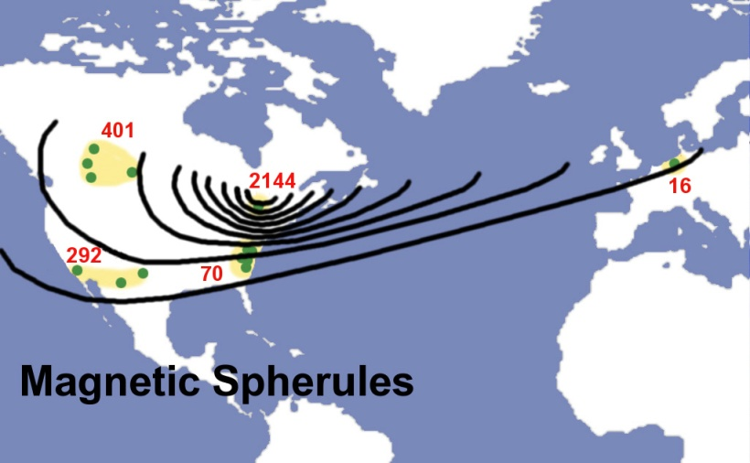
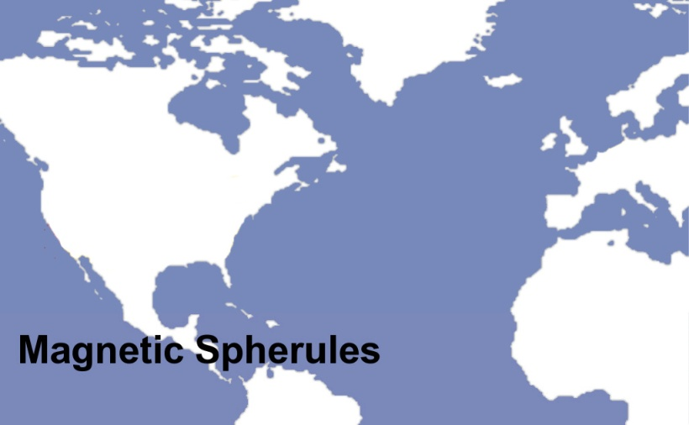
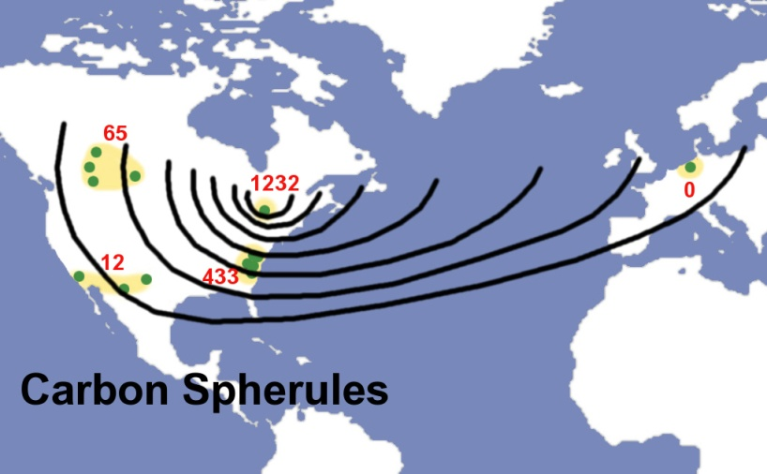

Distribution
of Evidence
........
Marker abundances increase toward Eastern Canada.
..........
Focus of the YD Impact Event:
airburst/ impacts in Canada,
in/ over Laurentide Ice Sheet.
.........
Notes:
So something blew up! But what happened because of it….

Slide 42
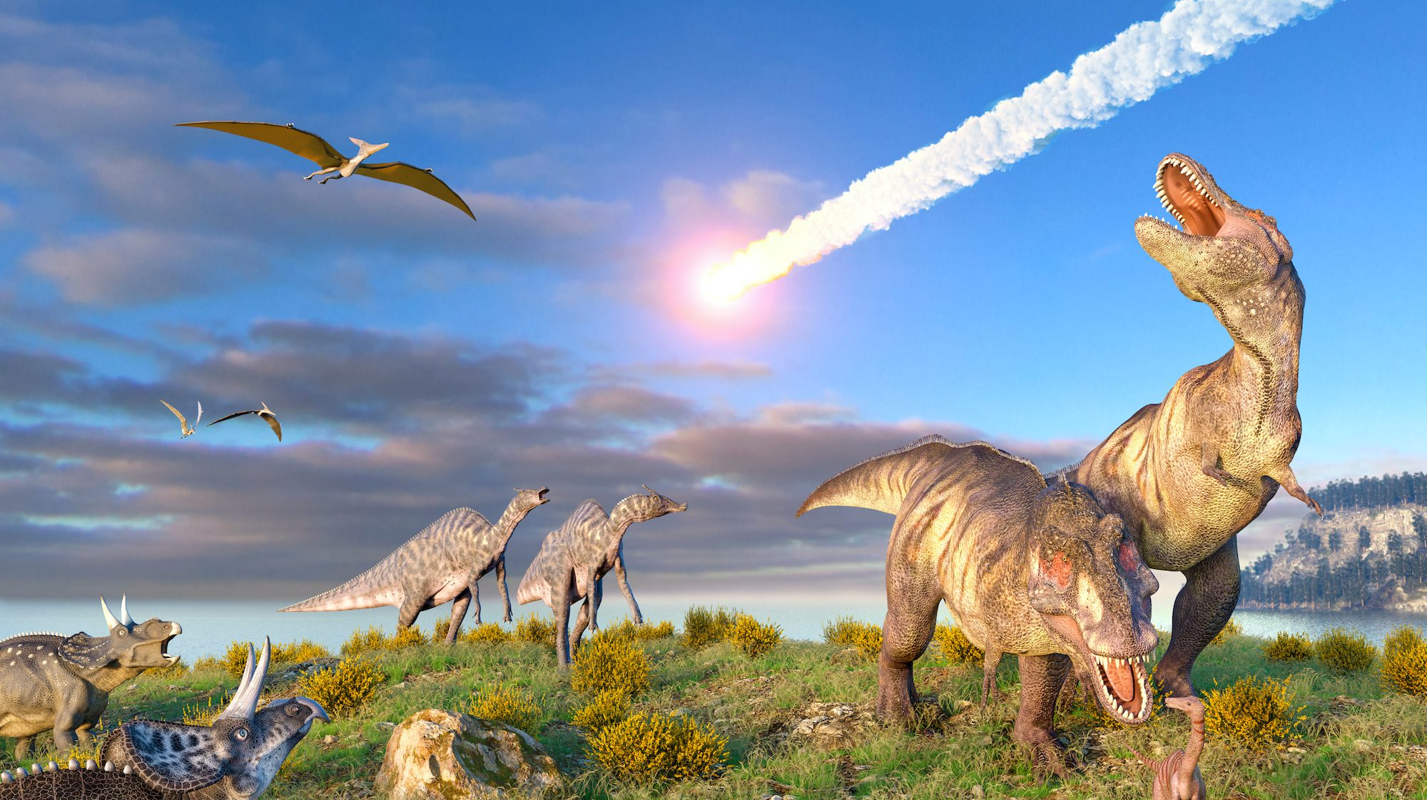
Possible Causes for the Extinctions
Human Overkill
Climate Change
Pandemic Disease
The YD Impact
1) Overkill Theory: the Clovis people hunted them to extinction,
because the animals had no fear of man.
Seems plausible; humans are known to have caused extinctions.

Slide 43

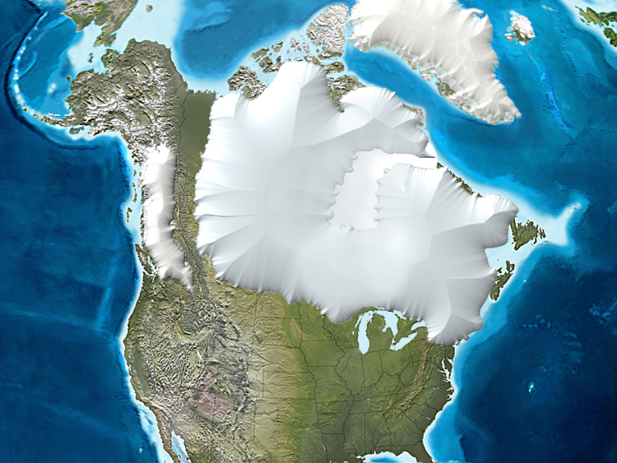
PaleoAmerican Migration Routes
Greenland
Ice Sheet
Laurentide Ice Sheet
Cordilleran
Ice Sheet

Slide 44
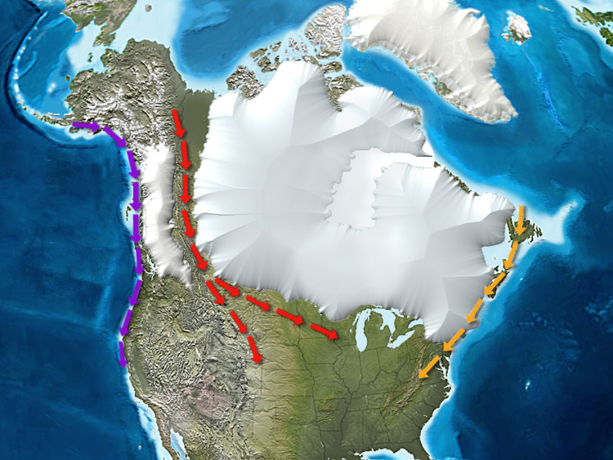
PaleoAmerican Migration Routes
Pacific
Route
Ice-free Corridor
Atlantic
Route
Virgin Continent
Virgin Continent

Slide 45
Overkill
Considerable debate for N America; no resolution…
Did Clovis people kill 5% or 100%?
Asia: Megafauna hunted there for millennia
Familiar with man, yet went extinct there, too.

Slide 46
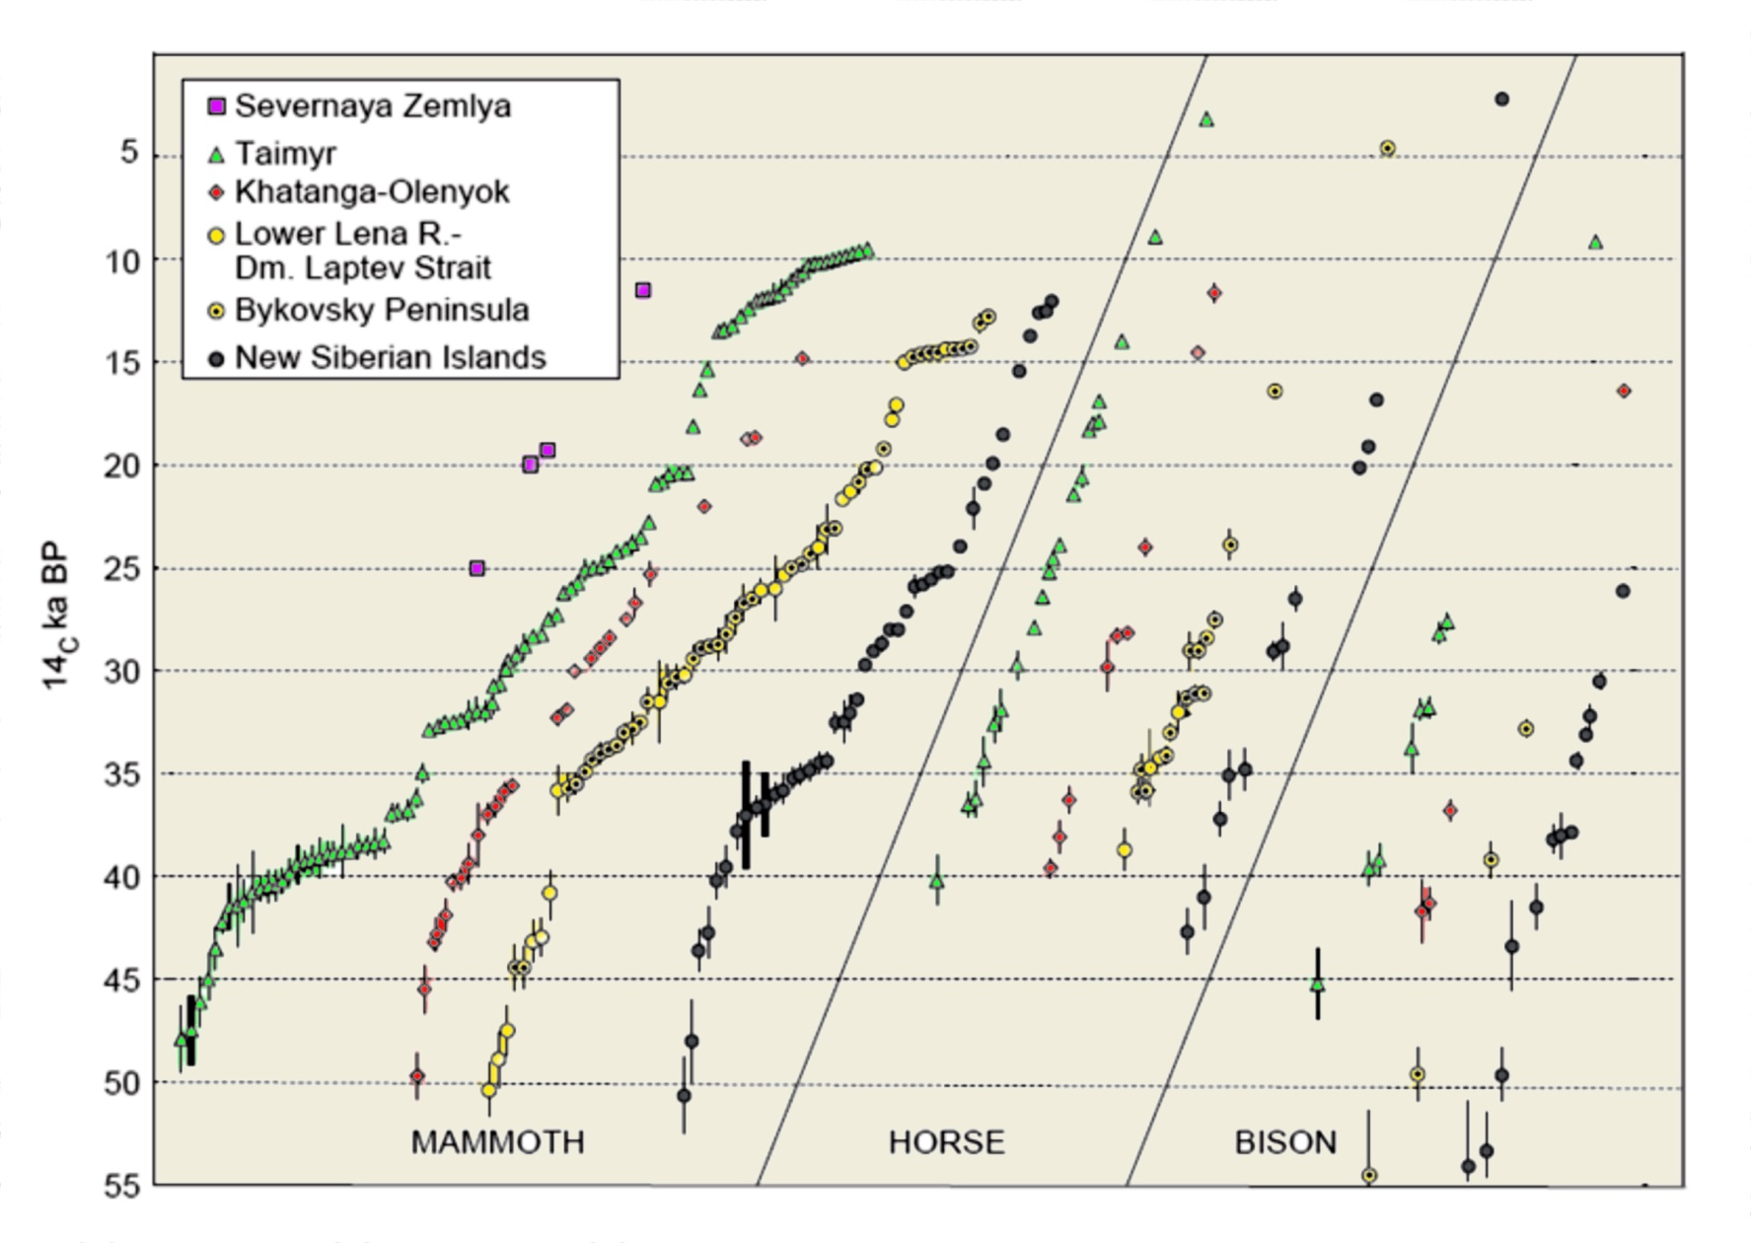
Siberian Extinctions
YDB Event
Dates on mammoth, horse and bison from the Siberian Arctic.
Source: Sher et al. (2003) 3rd International Mammoth Conference, Yukon Territory, Canada.

Slide 47
Siberian Extinctions
YDB Event
Dates on mammoth, horse and bison from the Siberian Arctic.
Source: Sher et al. (2003) 3rd International Mammoth Conference, Yukon Territory, Canada.

Slide 48
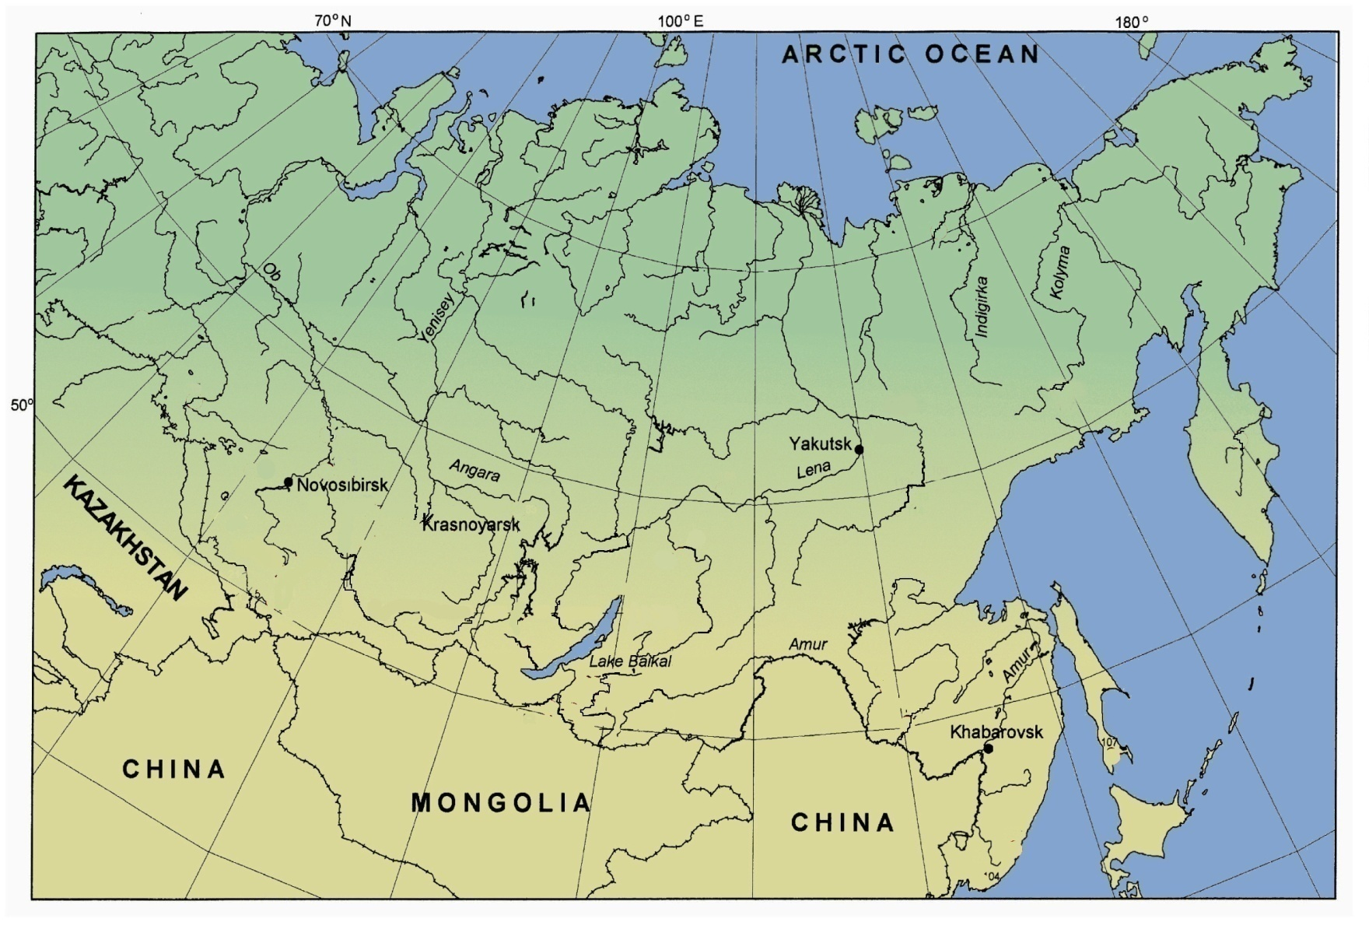
Siberian Extinctions

Slide 49
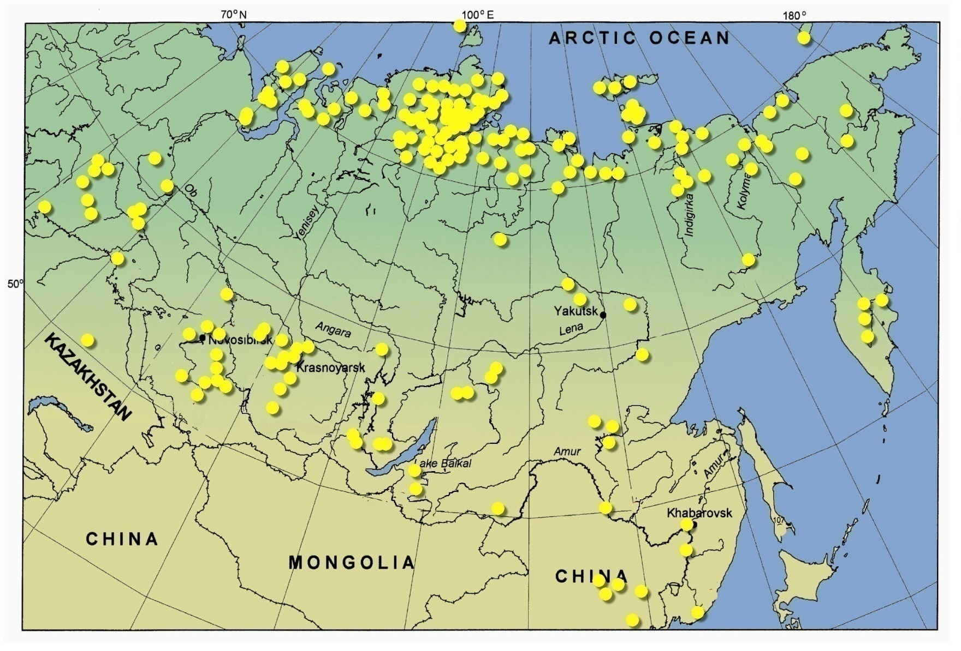
Siberian Extinctions
202 Dated Mammoth Sites
Mammoth sites plotted by Viacheslav Gusiakov, Head, Tsunami Laboratory, Russian Academy of Sciences.
Taken from Kuzmin & Orlova. (2004). Earth Science Reviews, 68, pp. 133-169.

Slide 50
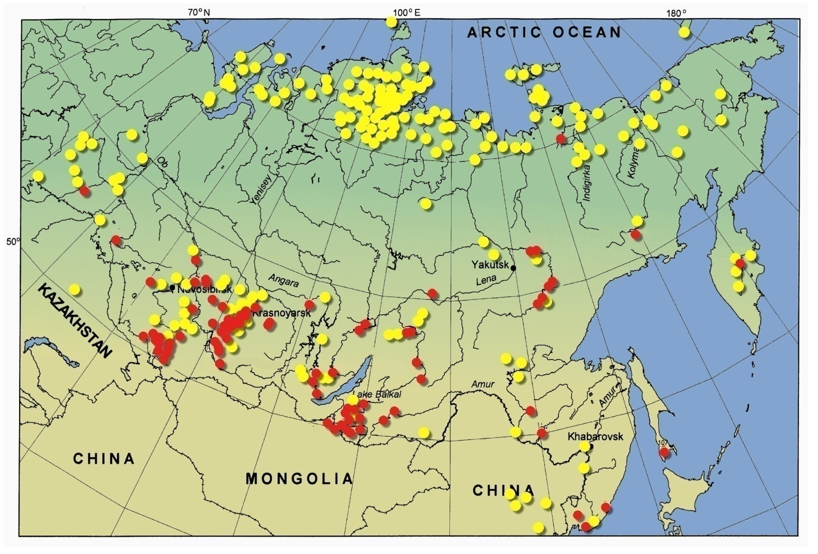
Siberian Extinctions
Only 1 Clovis-aged sites in extreme northern Siberia.
Yet, animals went extinct there, too.
What caused extinctions if NO HUNTERS?
202 Dated Mammoth Sites
117 Dated Paleolithic Sites
Mammoth sites plotted by Viacheslav Gusiakov, Head, Tsunami Laboratory, Russian Academy of Sciences.
Taken from Kuzmin & Orlova. (2004). Earth Science Reviews, 68, pp. 133-169.
(2) Human occupation data taken from Vasil'ev, et al. (2002). Radiocarbon, Vol 44, No. 2, pp. 503–530

Slide 51

Humans likely contributed to the extinctions…
(2) Climate change theory claims:
but could they have been the only cause?
as the Younger Dryas began, the return to near-glacial temperatures killed the animals.
What about Climate?

Slide 52
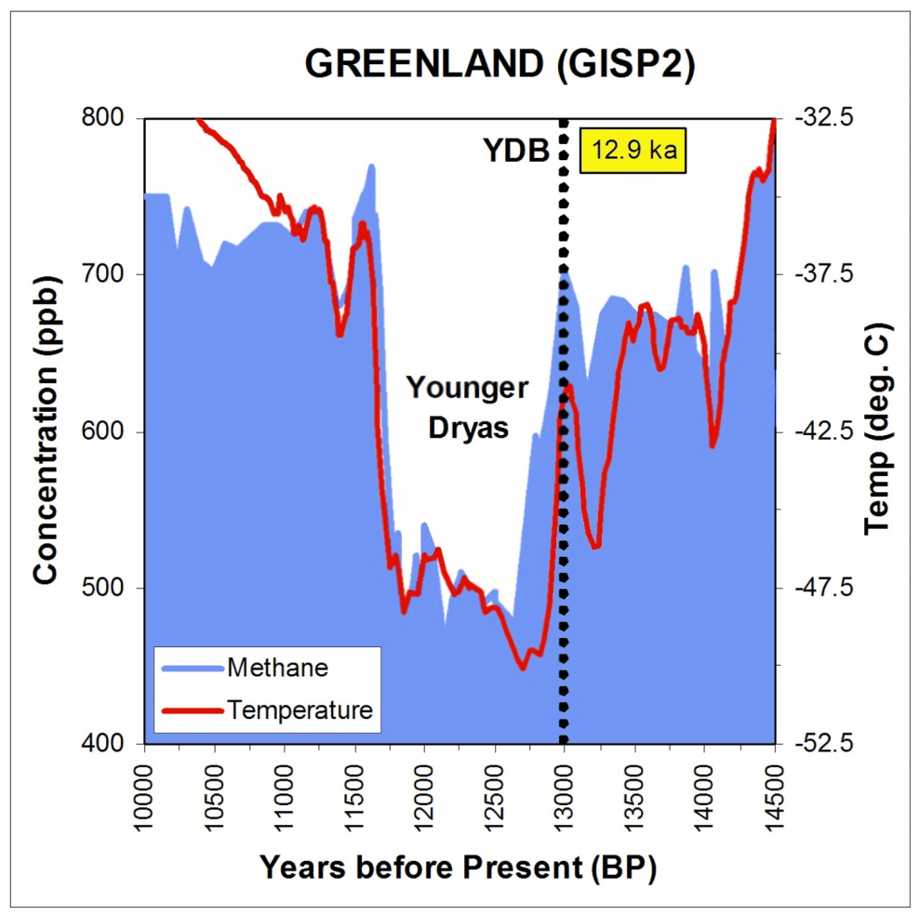
YD Cooling
According to Greenland ice core data, the Younger Dryas began ~12.9 ka ago.
Temperatures dropped quickly
>10 deg. C (18 deg. F).
Imagine if average temps in the U.S. dropped 10 degrees C and stayed there for more than 1000 years.
Typical solution: animals migrate and go extinct locally but not globally.

Slide 53
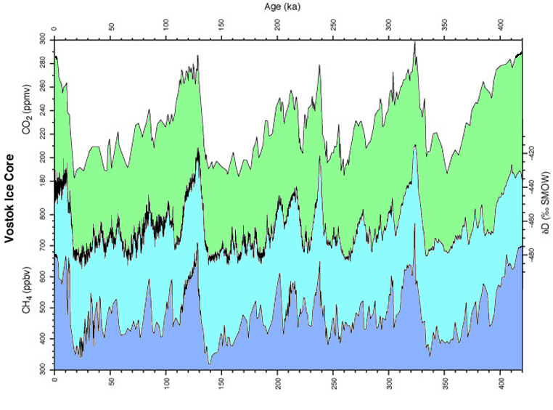
Problem with the climate theory…
Antarctica, 400,000 Years of Temperatures
~100,000-year
average
Age (ka)
Each past ice age was a long cooling followed by brief warming.
Many ice ages, each ~100,000 years
NO PREVIOUS EXTINCTIONS
So, extinctions NOT caused by CLIMATE
At the start of each ice age, temperatures plunged.
Temperature drops more severe than YD, but
no waves of extinctions.
YD Impact
Petit et al., 1999

Slide 54
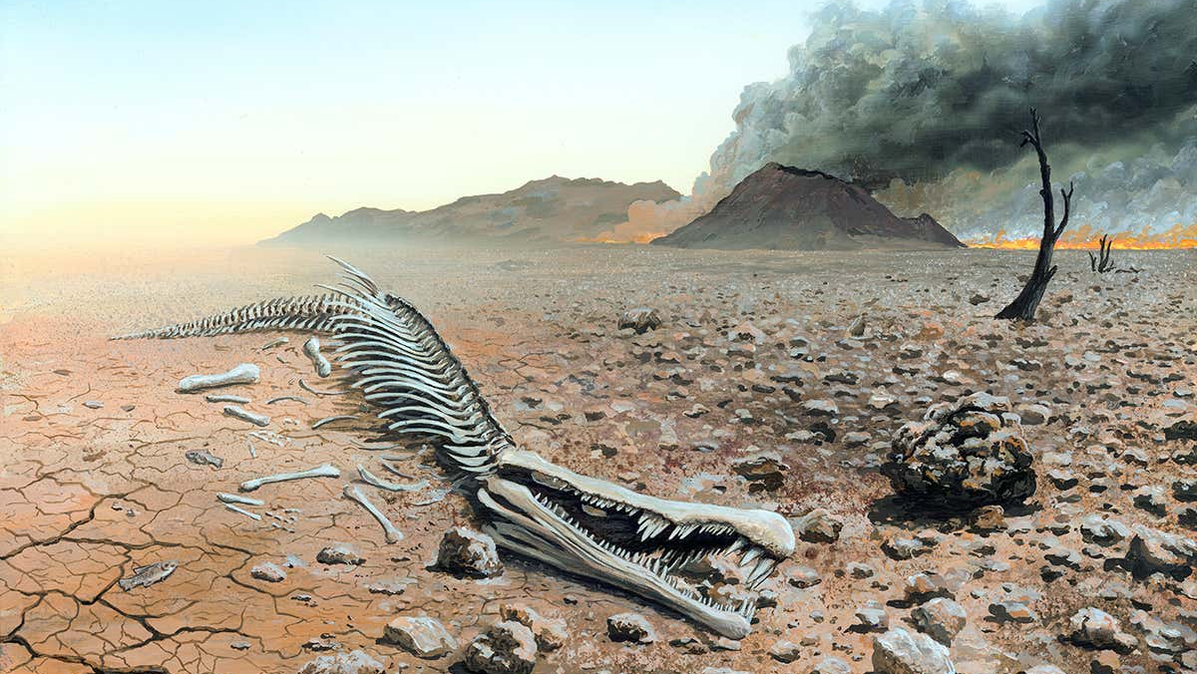
but what about humans?
Impact Event as Cause
not the only factor in the extinctions,
but it was a major one:
1) massive explosions
2) intense firestorms
3) habitat destruction
4) toxic chemicals
5) sudden climate change
affecting animals and plants….

Slide 55


Points as Population Proxies
Comparison of Clovis to post-Clovis points
(aka ‘Redstones’)
South Carolina: Redstones
South Carolina: Clovis Complex
Very few Redstones
100s of Clovis points
Redstone point distribution
Clovis point distribution

Slide 56


Points and Population
Clovis points
After 12.9 ka in
SC, NC, & VA
Human population decline of 60-80%
Recently has been
extended across
most of eastern U.S.
vs.
Redstone
points
Redstone
Clovis

Slide 57


Plains Population Decline?
PaleoAmerican Sites only on Great Plains & Rockies
YD IMPACT
~10,900 RCYBP
The number of western sites suggests a
post-Clovis population decline of >50%.
20 Folsom Sites
23 Clovis
Sites
10900
Folsom
Clovis
True for Western U.S., too?

Slide 58
The Impactor
What cosmic objects could have
produced all this evidence?
    But left no visible craters,
    no melted impact rocks, and yet
    left debris across four continents
    Here’s a strong possibility.

Slide 59

A Fragmented Comet
like Schwassmann-
Wachmann 3-B
NASA photo
600 km
--One-third width of the U.S.
--More than 100 major fragments
--Would yield more than 100 large airbursts
--Total mass is equivalent to ≈4-km-wide object

Slide 60

Impactor hypothesis
Numerous fragments of a comet
Dust-sized to 2 km wide
A few ice craters
Tunguska-like airbursts
Widespread canopy of fire
Intense continental firestorms
High-temperature shock waves

Slide 61

This is some of the story
….…
More to come
61

Slide 62

62

Slide 63

“The Bib”
63

Slide 64


Thank You
Cosmictusk.com
george@restorationsystems
64

